Slide 1
God’s Little Storybook About Art/Creation
This is a one month curriculum plan for art/vocabulary and scripture inspired by God’s Creation.

Slide 2
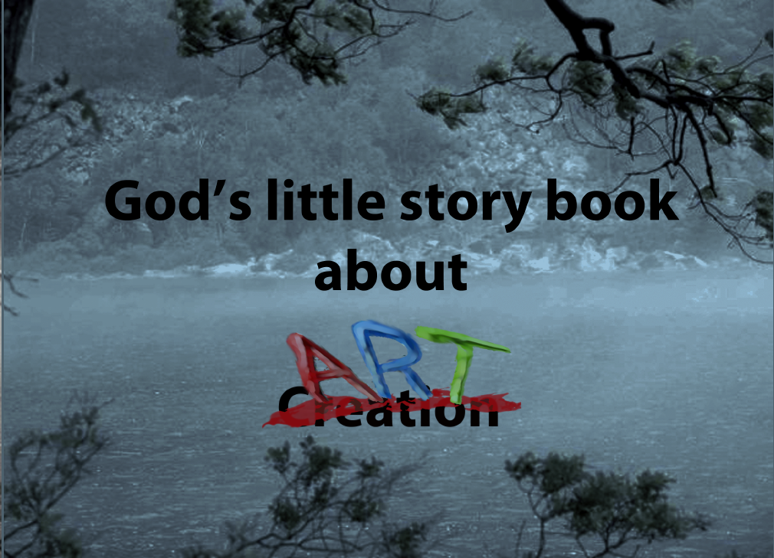
Notes:
God’s Little Storybook About Art/Creation
This is a one month curriculum plan for art/vocabulary and scripture inspired by God’s Creation
creation definition:
noun: The action or process of bringing something into existence: "the creation of a coalition government" synonyms: establishment, formation, foundation, initiation, institution.
A thing that has been made or invented, especially something showing artistic talent: "she treats fictional creations as if they were real people" synonyms: work, work of art, production.
The bringing into of existence of the universe, especially when regarded as an act of God.
Everything so created; the universe: "our alienation from the rest of Creation" synonyms: the world, the universe, the cosmos, the living world, the natural world nature, life, living things.
Art definition:
Noun: The expression or application of human creative skill and imagination, typically in a visual form such as painting or sculpture, producing works to be appreciated primarily for their beauty or emotional power: "the art of the Renaissance" synonyms: fine art, artwork
The various branches of creative activity, such as painting, music, literature, and dance: "the visual arts"
Lesson Plan for Cover
Questions: What form of art is on the cover? Possible answers: A photograph, a picture… The photograph is a digital color photo taken in fog and low light to give the impression of a black and white photo. Through the use of a computer, text and digital art was added.
Review vocabulary and definitions, discuss concepts.
Optional discussion on image meaning. “Why did the author create this image?” “What does it mean?” “What is unique about this artwork?”
Free DQuestions: What form of art is on the cover? Possible answers: A photograph, a picture… The photograph is a digital color photo taken in fog and low light to give the impression of a black and white photo. Through the use of a computer, text and digital art was added.
Review vocabulary and definitions, discuss concepts.
Optional discussion on image meaning. “Why did the author create this image?” “What does it mean?” “What is unique about this artwork?”
Free Draw, discuss drawing meaning.
Write in online journal about what you have learned

Slide 3
God’s little story book about Art/Creation
creation definition:
noun: The action or process of bringing something into existence: "the creation of a coalition government" synonyms: establishment, formation, foundation, initiation, institution.
A thing that has been made or invented, especially something showing artistic talent: "she treats fictional creations as if they were real people" synonyms: work, work of art, production.
The bringing into of existence of the universe, especially when regarded as an act of God.
Everything so created; the universe: "our alienation from the rest of Creation" synonyms: the world, the universe, the cosmos, the living world, the natural world nature, life, living things.
Art definition:
Noun: The expression or application of human creative skill and imagination, typically in a visual form such as painting or sculpture, producing works to be appreciated primarily for their beauty or emotional power: "the art of the Renaissance" synonyms: fine art, artwork
The various branches of creative activity, such as painting, music, literature, and dance: "the visual arts"

Slide 4
Lesson Plan for Cover
Questions: What form of art is on the cover? Possible answers: A photograph, a picture… The photograph is a digital color photo taken in fog and low light to give the impression of a black and white photo. Through the use of a computer, text and digital art was added.
Review vocabulary and definitions, discuss concepts.
Optional discussion on image meaning. “Why did the author create this image?” “What does it mean?” “What is unique about this artwork?”
Free Draw, discuss drawing meaning
Write in online journal about what you have learned

Slide 5
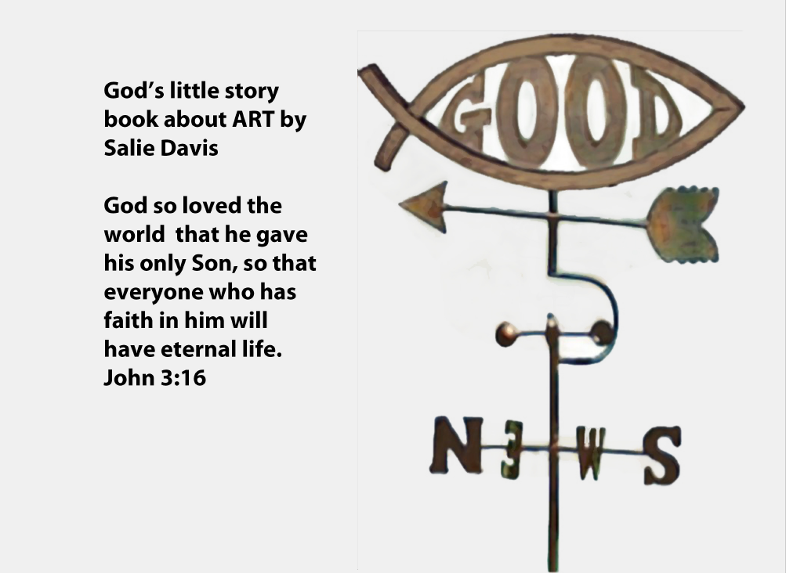
Notes:
digital art definition:
Noun: Art created or modified using a computer or other digital medium.
Lesson Plan for Authors Page
Questions: What form of art is on this page? Possible Answers: A weather vein, A picture, A photograph. This Image was created using a computer, photographs and digital art drawing.
Verse memorization: John 3:16 (any version)
Optional discussion on verse meaning and different verse variations
Optional discussion on image meaning. “Why did the author create this image?” “What does it mean?” “What is unique about this artwork?”
Review vocabulary and definitions, discuss concepts.
Free Draw, discuss meaning behind drawing.
Write in online journal about what you have learned
About the Author
Salie Davis has a BA in Creative Marketing and Media Communications. She has been an Artist since Birth and has experience as an art teacher designing and implementing Christian curriculum.

Slide 6
Authors Page
John 3:16
digital art definition:
Noun: Art created or modified using a computer or other digital medium.
About the Author
Salie Davis has a BA in Creative Marketing and Media Communications. She has been an Artist since Birth and has experience as an art teacher designing and implementing Christian curriculum.

Slide 7
Lesson Plan for Authors Page
Questions: What form of art is on this page? Possible Answers: A weather vein, A picture, A photograph. This Image was created using a computer, photographs and digital art drawing.
Verse memorization: John 3:16 (any version)
Optional discussion on verse meaning and different verse variations
Optional discussion on image meaning. “Why did the author create this image?” “What does it mean?” “What is unique about this artwork?”
  Review vocabulary and definitions, discuss concepts.
  Free Draw, discuss meaning behind drawing
  Write in online journal about what you have learned

Slide 8
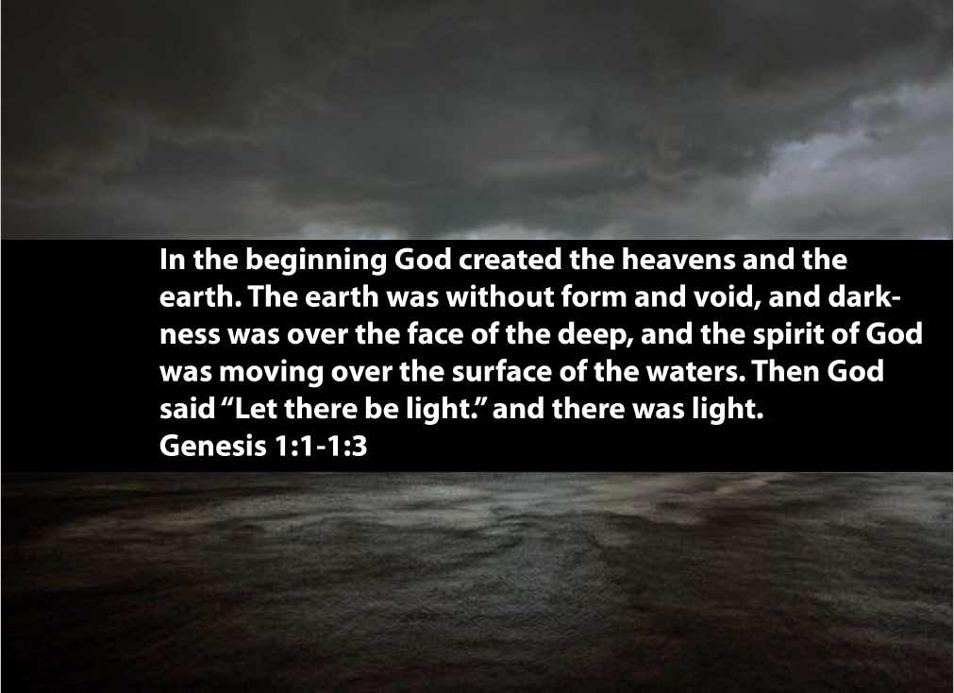
Notes:
Genesis 1:1-1:3
light definition:
Noun: The natural agent that stimulates sight and makes things visible: ‘the light of the sun’
‘the lamps in the street shed a faint light into the room’
A source of illumination, especially an electric lamp: ‘a light came on in his room’
lights Decorative illuminations: ‘Christmas lights’
An expression in someone's eyes indicating a particular emotion or mood:
‘a shrewd light entered his eyes’
lights A person's opinions, standards, and abilities: ‘leaving the police to do the job according to their lights’
Understanding of a problem or mystery; enlightenment:
‘she saw light dawn on the woman's face’
Spiritual illumination by divine truth.
Lesson Plan for Page 1
Questions: What form of art is on this page? Possible answers: A photograph. (Probe deeper) Is it in color or black and white? This image is in color in low light. (Probe Deeper) Why do images in low light seem to lack colour?
Memorize Genesis 1:1-1:3
Vocabulary (discuss different meanings for the word LIGHT)
Optional discussion on image meaning. “Why did the author create this image?” “What does it mean?” “What is unique about this artwork?”
Free Draw (suggestion, draw based on the verses learned, explain to students at the end of this lesson they will create a picture book about creation.)
Write in online journal about what you have learned

Slide 9
Page 1
Genesis 1:1-1:3
light definition:
Noun: The natural agent that stimulates sight and makes things visible: ‘the light of the sun’
‘the lamps in the street shed a faint light into the room’
A source of illumination, especially an electric lamp: ‘a light came on in his room’
lights Decorative illuminations: ‘Christmas lights’
An expression in someone's eyes indicating a particular emotion or mood:
‘a shrewd light entered his eyes’
lights A person's opinions, standards, and abilities: ‘leaving the police to do the job according to their lights’
Understanding of a problem or mystery; enlightenment:
‘she saw light dawn on the woman's face’
Spiritual illumination by divine truth.

Slide 10
Lesson Plan for Page 1
Questions: What form of art is on this page? Possible answers: A photograph. (Probe deeper) Is it in color or black and white? This image is in color in low light. (Probe Deeper) Why do images in low light seem to lack colour?
Memorize Genesis 1:1-1:3
Vocabulary (discuss different meanings for the word LIGHT)
Optional discussion on image meaning. “Why did the author create this image?” “What does it mean?” “What is unique about this artwork?”
Free Draw (suggestion, draw based on the verses learned, explain to students at the end of this lesson they will create a picture book about creation.)
Write in online journal about what you have learned

Slide 11
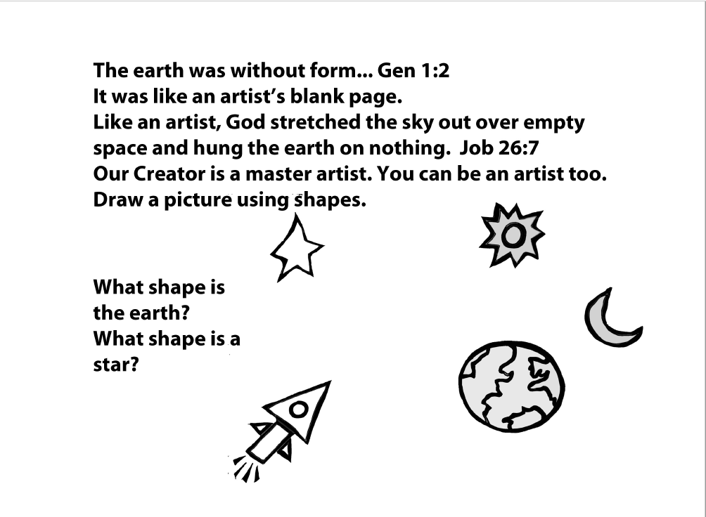
Notes:
Job 26:7
artist definition
noun: A person who creates paintings or drawings as a profession or hobby.
A person who practices or performs any of the creative arts, such as a sculptor, film-maker, actor, or dancer.
A person skilled at a particular task or occupation: ‘a surgeon who is an artist with the scalpel’
Lesson Plan for Page 2
Questions: What type of art is on this page? Possible answers: A drawing, A black and white picture.
What shapes can you see in the objects around you?
What makes you an artist?
Memorize Job 27:7
Review Genesis 1:1-1:3Questions: What type of art is on this page? Possible answers: A drawing, A black and white picture.
What shapes can you see in the objects around you?
What makes you an artist?
Memorize Job 27:7
Review Genesis 1:1-1:3
Vocabulary (discuss different meanings for the word Artist)
Optional discussion, “Why did the artist create this image?”
Drawing and question prompts from page
Write in online journal about what you have learned

Slide 12
Page 2
Job 26:7
artist definition
noun: A person who creates paintings or drawings as a profession or hobby.
A person who practices or performs any of the creative arts, such as a sculptor, film-maker, actor, or dancer.
A person skilled at a particular task or occupation: ‘a surgeon who is an artist with the scalpel’

Slide 13
Lesson Plan for Page 2
Questions: What type of art is on this page? Possible answers: A drawing, A black and white picture.
What shapes can you see in the objects around you?
What makes you an artist?
Memorize Job 27:7
Review Genesis 1:1-1:3
Vocabulary (discuss different meanings for the word Artist)
Optional discussion, “Why did the artist create this image?”
Drawing and question prompts from page
Write in online journal about what you have learned

Slide 14
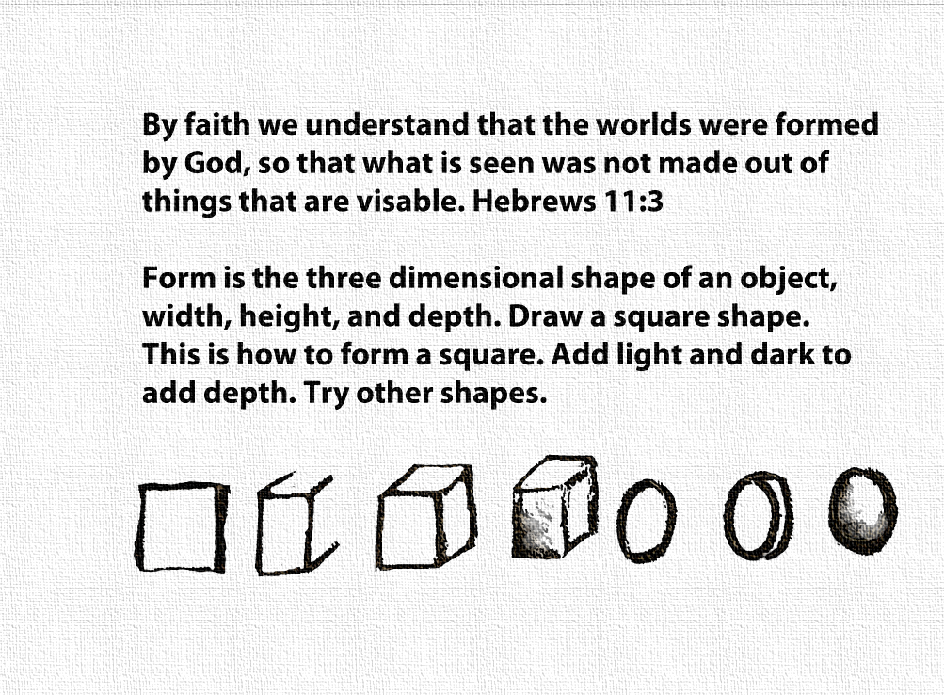
Notes:
Hebrews 11:3
form definition
Noun: The visible shape or configuration of something:
‘the form, colour, and texture of the tree’
[mass noun] ‘the flowers of this shrub are remarkable both in form and colour’
The body or shape of a person or animal.
mass noun] Style, design, and arrangement in an artistic work as distinct from its content: ‘these videos are a triumph of form over content’
Three-dimensional definition
Adjective: Having or appearing to have length, breadth, and depth:
‘a three-dimensional object’
(of a literary or dramatic work) sufficiently full in characterization and representation of events to be believable: ‘the drama is never anything less than three-dimensional’
Lesson Plan for Page 3
Questions: What types of tools can be used to make drawings? Possible answers: Pencil, Crayon, Marker, Paint, Chalk.
How can drawings that are flat appear to be three dimensional.
Using the square, label the lines that represent height, width and depth and create the perception of three-dimensions.
What makes you an artist?
Memorize Hebrews 11:3
Vocabulary (discuss different meanings for the words form and three-dimQuestions: What types of tools can be used to make drawings? Possible answers: Pencil, Crayon, Marker, Paint, Chalk.
How can drawings that are flat appear to be three dimensional.
Using the square, label the lines that represent height, width and depth and create the perception of three-dimensions.
What makes you an artist?
Memorize Hebrews 11:3
Vocabulary (discuss different meanings for the words form and three-dimensional)
Drawing prompts from page
Write in online journal about what you have learned

Slide 15
Page 3
Hebrews 11:3
form definition
Noun: The visible shape or configuration of something:
‘the form, colour, and texture of the tree’
[mass noun] ‘the flowers of this shrub are remarkable both in form and colour’
The body or shape of a person or animal.
mass noun] Style, design, and arrangement in an artistic work as distinct from its content: ‘these videos are a triumph of form over content’
Three-dimensional definition
Adjective: Having or appearing to have length, breadth, and depth:
‘a three-dimensional object’
(of a literary or dramatic work) sufficiently full in characterization and representation of events to be believable: ‘the drama is never anything less than three-dimensional’

Slide 16
Lesson Plan for Page 3
Questions: What types of tools can be used to make drawings? Possible answers: Pencil, Crayon, Marker, Paint, Chalk.
How can drawings that are flat appear to be three dimensional.
Using the square, label the lines that represent height, width and depth and create the perception of three-dimensions.
What makes you an artist?
Memorize Hebrews 11:3
Vocabulary (discuss different meanings for the words form and three-dimensional)
Drawing prompts from page
Write in online journal about what you have learned

Slide 17
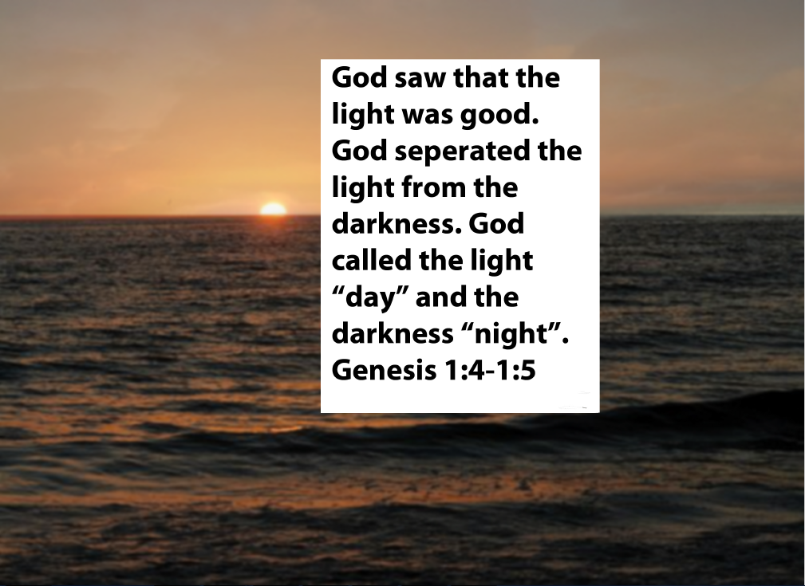
Notes:
Genesis 1:4-1:5
Darkness definition
Noun: The partial or total absence of light:
‘the office was in darkness’
Night: ‘they began to make camp before darkness fell’
The quality of being dark in colour:‘the darkness of his jacket’
Wickedness or evil: ‘the forces of darkness’
Lesson Plan for Page 4
Questions: Reflection on the last two colour photographs that appeared black and white due to the lack of light, in this photograph, what has happened with the introduction of more light? What time of day is this? Possible answers: Morning, Early evening.
What colour is the sky and ocean in this picture?
What colour is the sky and ocean in the middle of the day? In the middle of the night?
Why do you think that this is?
Memorize Genesis 1:4-1:5
Vocabulary (discuss different meanings for the word darkness)
Free Draw (suggestion based on verse prompt)
Write in online journal about what you have learned

Slide 18
Page 4
Genesis 1:4-1:5
Darkness definition
Noun: The partial or total absence of light:
‘the office was in darkness’
Night: ‘they began to make camp before darkness fell’
The quality of being dark in colour:‘the darkness of his jacket’
Wickedness or evil: ‘the forces of darkness’

Slide 19
Lesson Plan for Page 4
Questions: Reflection on the last two colour photographs that appeared black and white due to the lack of light, in this photograph, what has happened with the introduction of more light? What time of day is this? Possible answers: Morning, Early evening.
What colour is the sky and ocean in this picture?
What colour is the sky and ocean in the middle of the day? In the middle of the night?
Why do you think that this is?
Memorize Genesis 1:4-1:5
Vocabulary (discuss different meanings for the word darkness)
Free Draw (suggestion based on verse prompt)
Write in online journal about what you have learned

Slide 20
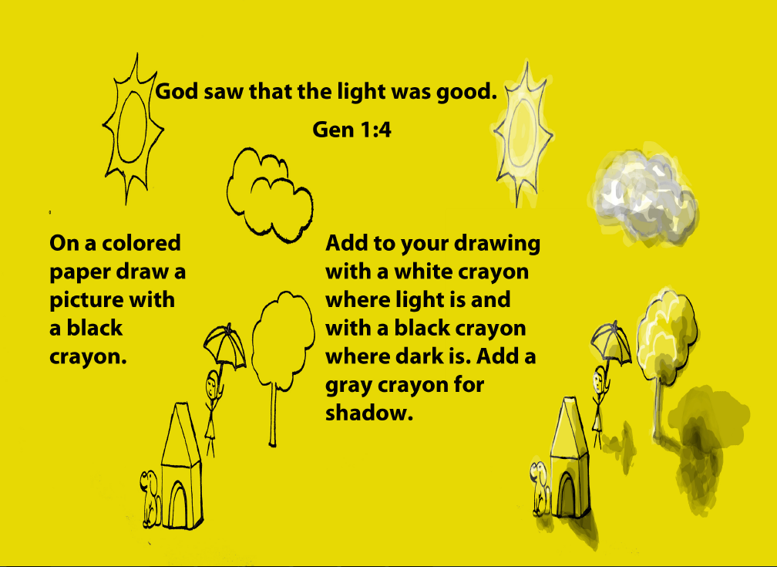
Notes:
Lesson Plan for Page 5
Review all vocabulary
Review verses John 3:16, Job 27:7, Hebrews 11:3
Drawing prompts from Page
Write in online journal about what you have learned

Slide 21
Lesson Plan for Page 5
Review all vocabulary
Review verses John 3:16, Job 27:7, Hebrews 11:3
Drawing prompts from Page
Write in online journal about what you have learned

Slide 22
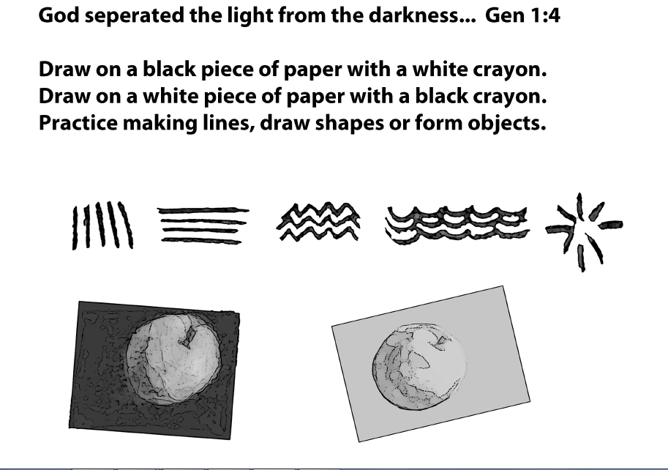
Notes:
Line
Noun: A long, narrow mark or band:
‘a row of closely spaced dots will look like a continuous line’
‘I can't draw a straight line’
Mathematics A straight or curved continuous extent of length without breadth.
A direct course:‘the ball rose in a straight line’
A furrow or wrinkle in the skin, especially on the face:‘there were new lines round her eyes and mouth’
‘laughter lines’
A contour or outline considered as a feature of design or composition:‘crisp architectural lines’
[mass noun] ‘the artist's use of clean line and colour’ Line
Noun: A long, narrow mark or band:
‘a row of closely spaced dots will look like a continuous line’
‘I can't draw a straight line’
Mathematics A straight or curved continuous extent of length without breadth.
A direct course:‘the ball rose in a straight line’
A furrow or wrinkle in the skin, especially on the face:‘there were new lines round her eyes and mouth’
‘laughter lines’
A contour or outline considered as a feature of design or composition:‘crisp architectural lines’
[mass noun] ‘the artist's use of clean line and colour’
Lesson Plan for Page 6
Review Gen 1:4-1:5
Vocabulary (discuss different meanings for the word line)
Drawing prompts from pageReview Gen 1:4-1:5
Vocabulary (discuss different meanings for the word line)
Drawing prompts from page
Write in online journal about what you have learned

Slide 23
Page 6
Line
Noun: A long, narrow mark or band:
‘a row of closely spaced dots will look like a continuous line’
‘I can't draw a straight line’
Mathematics A straight or curved continuous extent of length without breadth.
A direct course:‘the ball rose in a straight line’
A furrow or wrinkle in the skin, especially on the face:‘there were new lines round her eyes and mouth’
‘laughter lines’
A contour or outline considered as a feature of design or composition:‘crisp architectural lines’
[mass noun] ‘the artist's use of clean line and colour’

Slide 24
Lesson Plan for Page 6
Review Gen 1:4-1:5
Vocabulary (discuss different meanings for the word line)
Drawing prompts from page
Write in online journal about what you have learned

Slide 25
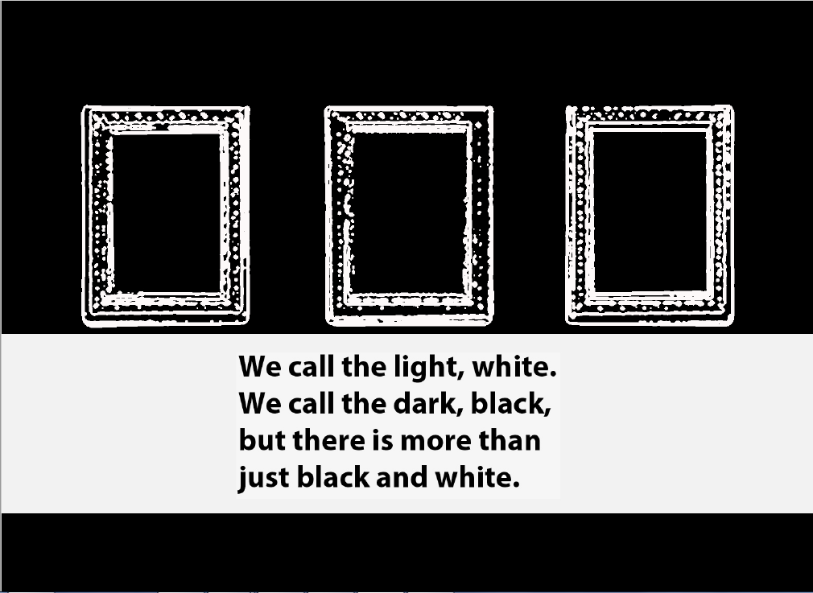
Notes:
Black definition
Adjective: Of the very darkest colour owing to the absence of or complete absorption of light; the opposite of white:
‘black smoke’, ‘her long black hair’
noun : Black colour or pigment: ‘a tray decorated in black and green’
Black clothes or material, typically worn as a sign of mourning:‘only one or two of the mourners were in black’
Darkness, especially of night or an overcast sky:‘the only thing visible in the black was the light of the torch’
White definition
Adjective: Of the colour of milk or fresh snow, due to the reflection of all visible rays of light; the opposite of black: ‘a sheet of white paper’
Noun: White colour or pigment:‘garnet-red flowers flecked with white’
Black and White definition
(of a photograph, film, television programme, etc.) in black, white, shades of grey, and no other colour: ‘old black-and-white movies’
(of a situation or debate) involving clearly defined opposing principles or issues:
‘it was all grey areas; no black-and-white certainties’
Lesson Plan for Page 7
Vocabulary (discuss different meanings for the words and phrase, black and white)
Free Draw in black and white
Review all verses
Write in online journal about what you have learned

Slide 26
Page 7
Black definition
Adjective: Of the very darkest colour owing to the absence of or complete absorption of light; the opposite of white:
‘black smoke’, ‘her long black hair’
noun : Black colour or pigment: ‘a tray decorated in black and green’
Black clothes or material, typically worn as a sign of mourning:‘only one or two of the mourners were in black’
Darkness, especially of night or an overcast sky:‘the only thing visible in the black was the light of the torch’
White definition
Adjective: Of the colour of milk or fresh snow, due to the reflection of all visible rays of light; the opposite of black: ‘a sheet of white paper’
Noun: White colour or pigment:‘garnet-red flowers flecked with white’
Black and White definition
(of a photograph, film, television programme, etc.) in black, white, shades of grey, and no other colour: ‘old black-and-white movies’
(of a situation or debate) involving clearly defined opposing principles or issues:
‘it was all grey areas; no black-and-white certainties’

Slide 27
Lesson Plan for Page 7
Vocabulary (discuss different meanings for the words and phrase, black and white)
Free Draw in black and white
Review all verses
Write in online journal about what you have learned

Slide 28
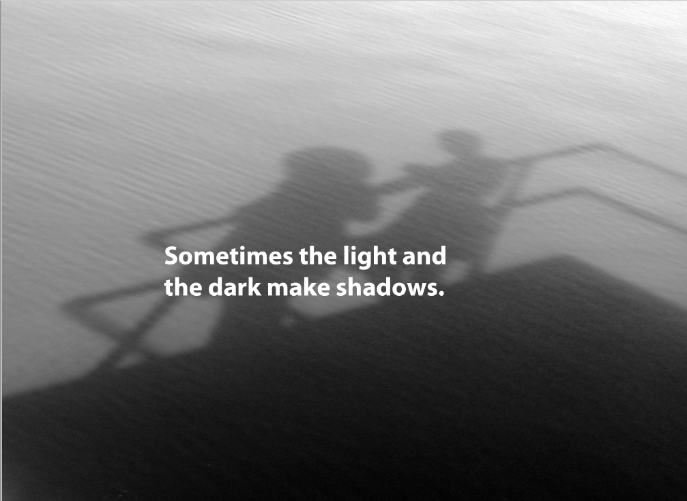
Notes:
Shadow definition
Noun: A dark area or shape produced by a body coming between rays of light and a surface: ‘trees cast long shadows’
Partial or complete darkness, especially as produced in this way: ‘the north side of the cathedral was deep in shadow’, ‘a stranger slowly approached from the shadows’
The shaded part of a picture.
A dark patch or area on a surface: ‘her face was pale and there were shadows under her eyes’
Lesson Plan for Page 8
Questions: Why does this colour photograph appear to be black, and white? Possible answers. The lack of light, because it is a picture of shadows.
Vocabulary (discuss different meanings for the word shadow)
Free Draw in black and white.
Review all verses
Write in online journal about what you have learned

Slide 29
Page 8
Shadow definition
Noun: A dark area or shape produced by a body coming between rays of light and a surface: ‘trees cast long shadows’
Partial or complete darkness, especially as produced in this way: ‘the north side of the cathedral was deep in shadow’, ‘a stranger slowly approached from the shadows’
The shaded part of a picture.
A dark patch or area on a surface: ‘her face was pale and there were shadows under her eyes’

Slide 30
Lesson Plan for Page 8
Questions: Why does this colour photograph appear to be black, and white? Possible answers. The lack of light, because it is a picture of shadows.
Vocabulary (discuss different meanings for the word shadow)
Free Draw in black and white.
Review all verses
Write in online journal about what you have learned

Slide 31
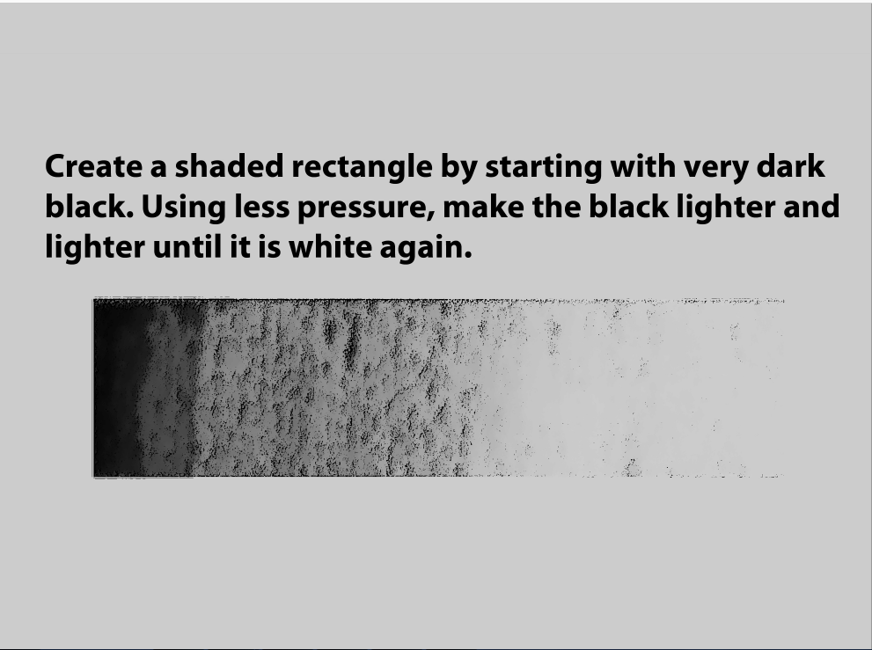
Notes:
Shade definition
Noun: Comparative darkness and coolness caused by shelter from direct sunlight: ‘sitting in the shade’
‘this area will be in shade for much of the day’
The darker part of a picture.
A colour, especially with regard to how light or dark it is or as distinguished from one nearly like it:
‘various shades of blue’ ‘Maria's eyes darkened in shade’
Art: A slight degree of difference between colours.
Lesson Plan for Page 9
Vocabulary (discuss different meanings for the word shade)
Drawing prompt from page
Test on all verses

Slide 32
Page 9
Shade definition
Noun: Comparative darkness and coolness caused by shelter from direct sunlight: ‘sitting in the shade’
‘this area will be in shade for much of the day’
The darker part of a picture.
A colour, especially with regard to how light or dark it is or as distinguished from one nearly like it:
‘various shades of blue’ ‘Maria's eyes darkened in shade’
Art: A slight degree of difference between colours.

Slide 33
Lesson Plan for Page 9
Vocabulary (discuss different meanings for the word shade)
Drawing prompt from page
Test on all verses

Slide 34
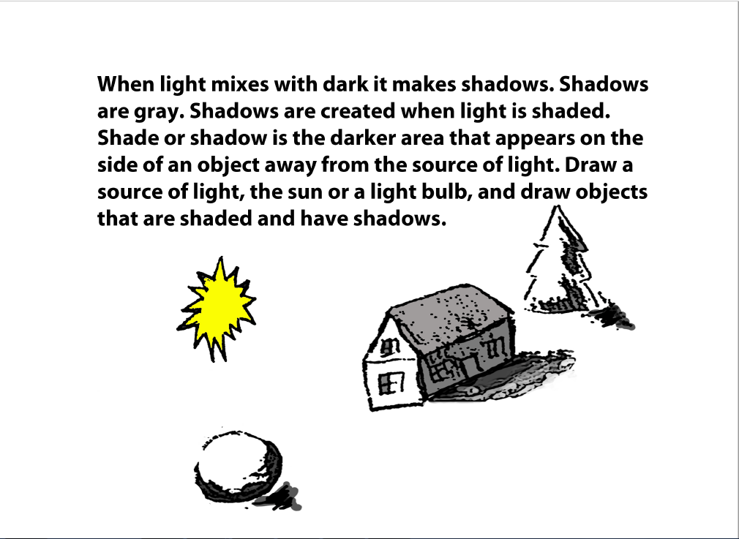
Notes:
Lesson Plan for Page 10
Drawing Prompts from Page
Go over verse test
Write in online journal about what you have learned

Slide 35
Lesson Plan for Page 10
Drawing Prompts from Page
Go over verse test
Write in online journal about what you have learned

Slide 36
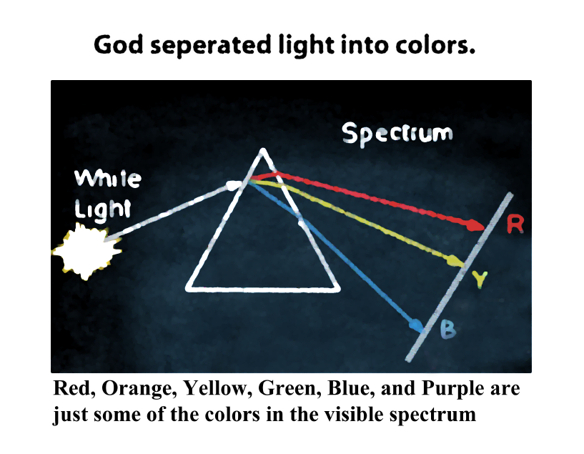
Notes:
Lesson Plan for Page 11
Review all vocabulary
Do a spectrum light demonstration with a prism
Draw an image using all concepts taught.
Discuss in class vocabulary concepts and how they relate to the image drawn.
Write in online journal about what you have learned

Slide 37
Lesson Plan for Page 11
Review all vocabulary
Do a spectrum light demonstration with a prism
Draw an image using all concepts taught.
Discuss in class vocabulary concepts and how they relate to the image drawn.
Write in online journal about what you have learned

Slide 38
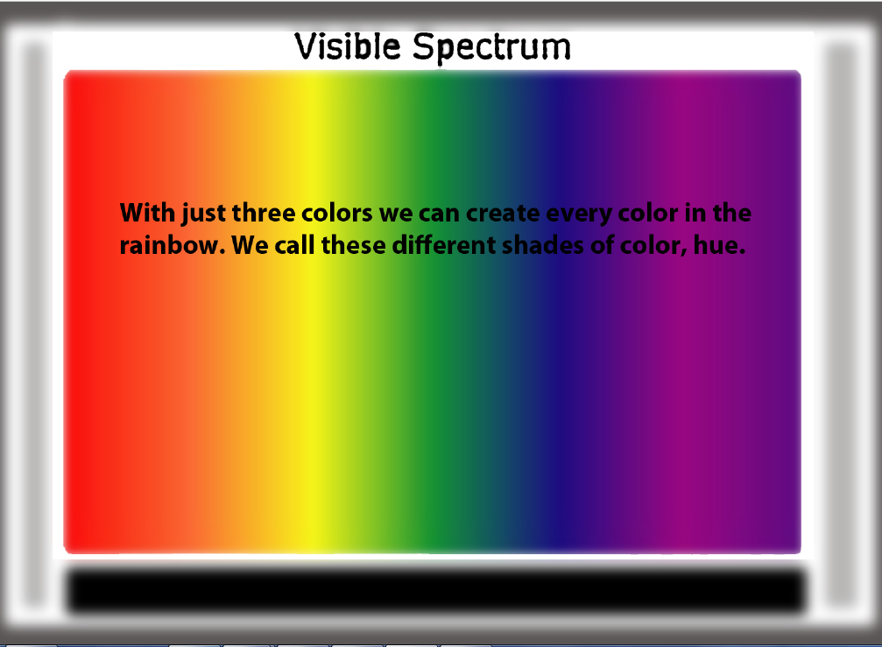
Notes:
Spectrum definition:
Noun: A band of colours, as seen in a rainbow, produced by separation of the components of light by their different degrees of refraction according to wavelength.
Hue definition:
Noun: A colour or shade:
‘the water is the deepest hue of aquamarine’
Lesson Plan for Page 12
Vocabulary test
New Vocabulary words, Spectrum and Hue
Draw an image using all concepts taught.
Discuss in class vocabulary concepts and how they relate to the image drawn.
Write in online journal about what you have learned

Slide 39
Page 12
Spectrum definition:
Noun: A band of colours, as seen in a rainbow, produced by separation of the components of light by their different degrees of refraction according to wavelength.
Hue definition:
Noun: A colour or shade:
‘the water is the deepest hue of aquamarine’

Slide 40
Lesson Plan for Page 12
Vocabulary test
New Vocabulary words, Spectrum and Hue
Draw an image using all concepts taught.
Discuss in class vocabulary concepts and how they relate to the image drawn.
Write in online journal about what you have learned

Slide 41
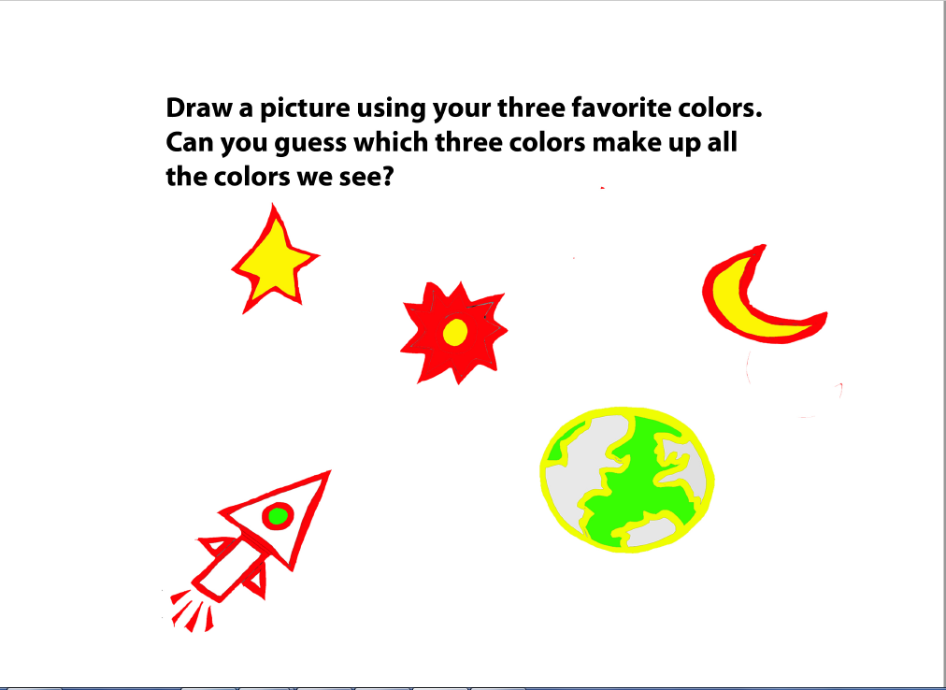
Notes:
Lesson Plan for Page 13
Drawing prompt from page
Discuss questions on page
Go over vocabulary test
Write in online journal about what you have learned

Slide 42
Lesson Plan for Page 13
Drawing prompt from page
Discuss questions on page
Go over vocabulary test
Write in online journal about what you have learned

Slide 43
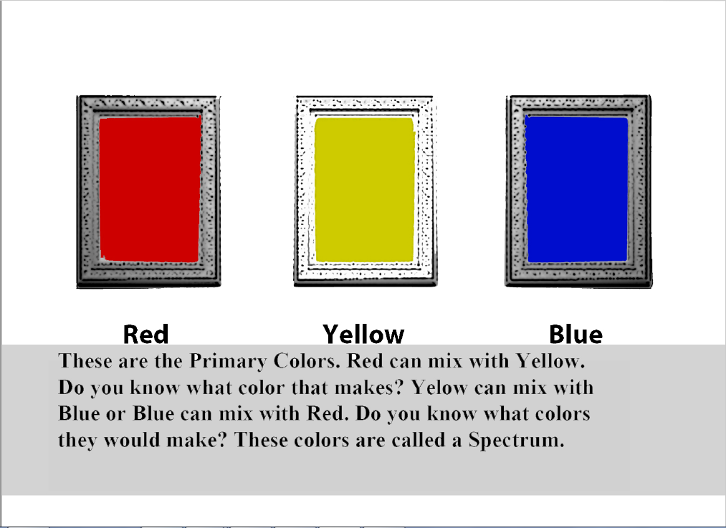
Notes:
Colour definition:
Noun: The property possessed by an object of producing different sensations on the eye as a result of the way it reflects or emits light: ‘the lights flickered and changed colour’
One, or any mixture, of the constituents into which light can be separated in a spectrum or rainbow, sometimes including (loosely) black and white:‘a rich brown colour’ ‘a range of bright colours’
The use of all colours, not only black and white, in photography or television:‘he has shot the whole film in colour’
Lesson Plan for page 14
Draw an image using all concepts taught. (Suggested mixing colors) Vocabulary, Colour.
Discuss question prompts on page.
Draw an image using all concepts taught. (Suggested mixing colors)
Discuss in class vocabulary concepts and how they relate to the image drawn.
Review Verses
Write in online journal about what you have learned

Slide 44
Page 14
Colour definition:
Noun: The property possessed by an object of producing different sensations on the eye as a result of the way it reflects or emits light: ‘the lights flickered and changed colour’
One, or any mixture, of the constituents into which light can be separated in a spectrum or rainbow, sometimes including (loosely) black and white:‘a rich brown colour’ ‘a range of bright colours’
The use of all colours, not only black and white, in photography or television:‘he has shot the whole film in colour’

Slide 45
Lesson Plan for page 14
Vocabulary, Colour.
Discuss question prompts on page.
Draw an image using all concepts taught. (Suggested mixing colors)
Discuss in class vocabulary concepts and how they relate to the image drawn.
Review Verses
Write in online journal about what you have learned

Slide 46
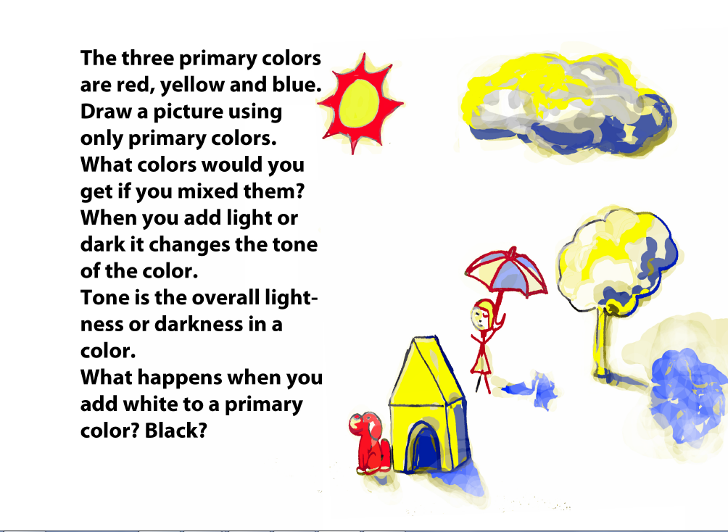
Notes:
Tone definition:
Noun: The particular quality of brightness, deepness, or hue of a shade of a colour: ‘stained glass in vivid tones of red and blue’
‘an attractive colour which is even in tone and texture’
The general effect of colour or of light and shade in a picture.
A slight degree of difference in the intensity of a colour.
Lesson Plan for Page 15
Discuss Primary colours (optional discussion of secondary colours.)
Vocabulary for the word, Tone.
Question Prompts on Page.
Drawing Prompts on Page.
Test on verses

Slide 47
Page 15
Tone definition:
Noun: The particular quality of brightness, deepness, or hue of a shade of a colour: ‘stained glass in vivid tones of red and blue’
‘an attractive colour which is even in tone and texture’
The general effect of colour or of light and shade in a picture.
A slight degree of difference in the intensity of a colour.

Slide 48
Lesson Plan for Page 15
Discuss Primary colours (optional discussion of secondary colours.)
Vocabulary for the word, Tone.
Question Prompts on Page.
Drawing Prompts on Page.
Test on verses

Slide 49
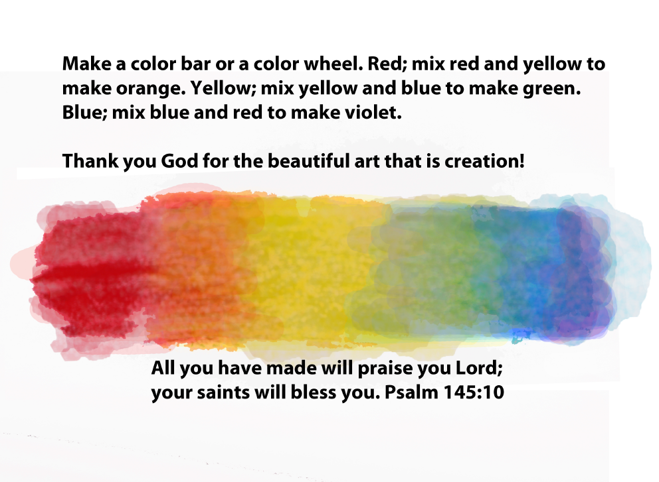
Notes:
Lesson Plan for Page 16
Memorize Psalm 145:10
Drawing Prompts on page
Review vocabulary; Spectrum, Hue, Colour and Tone.
Write in online journal about what you have learned

Slide 50
Lesson Plan for Page 16
Memorize Psalm 145:10
Drawing Prompts on page
Review vocabulary; Spectrum, Hue, Colour and Tone.
Write in online journal about what you have learned

Slide 51
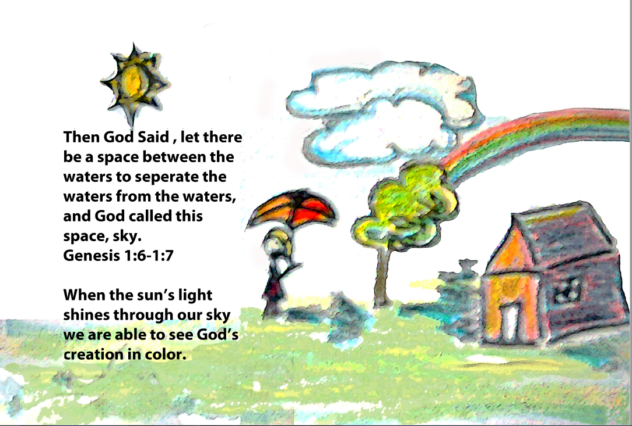
Notes:
Lesson Plan for Page 17
Questions: How is the sky similar to the prism we used earlier? Use this to explain the text on the page concerning how we see colour.
Learn new verse, Genesis 1:6-1:7
Review Psalm 145:10
Draw an image using all concepts taught.
Discuss in class vocabulary concepts and how they relate to the image on the page, and to the images drawn by the students.
Write in online journal about what you have learned

Slide 52
Lesson Plan for Page 17
Questions: How is the sky similar to the prism we used earlier? Use this to explain the text on the page concerning how we see colour.
Learn new verse, Genesis 1:6-1:7
Review Psalm 145:10
Draw an image using all concepts taught.
Discuss in class vocabulary concepts and how they relate to the image on the page, and to the images drawn by the students
Write in online journal about what you have learned

Slide 53
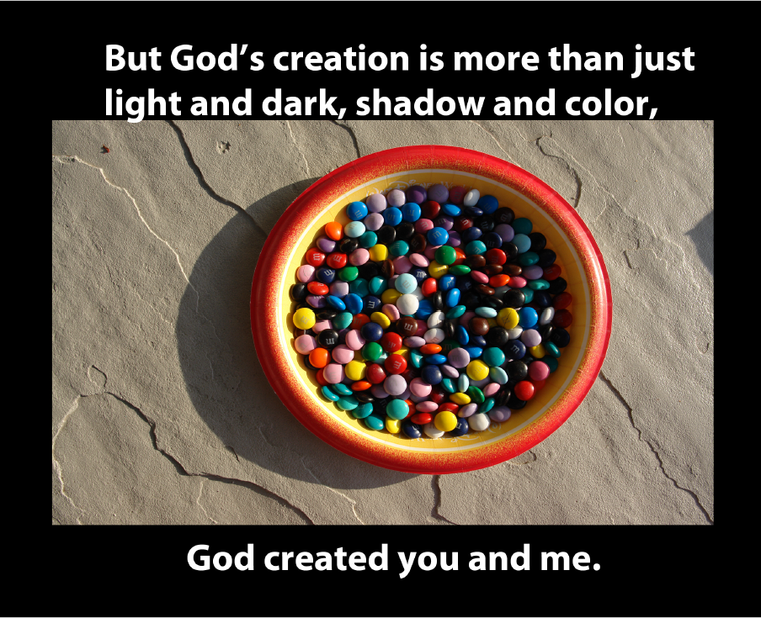
Notes:
Questions: Why did the artist choose this photograph for this page?
Discuss the meaning of the text on the page.
Review Genesis 1:6-1:7 and Psalm 145:10, Discuss verse meaning.
Test on new vocabulary
Draw an image using all concepts taught.
Discuss in class vocabulary concepts and how they relate to the image drawn.
Write in online journal about what you have learned

Slide 54
Lesson Plan for Page 18
Questions: Why did the artist choose this photograph for this page?
Discuss the meaning of the text on the page.
Review Genesis 1:6-1:7 and Psalm 145:10, Discuss verse meaning.
Test on new vocabulary
Draw an image using all concepts taught.
Discuss in class vocabulary concepts and how they relate to the image drawn.
Write in online journal about what you have learned
Notes:
Lesson Plan for Page 18
Questions: Why did the artist choose this photograph for this page?
Discuss the meaning of the text on the page.
Review Genesis 1:6-1:7 and Psalm 145:10, Discuss verse meaning.
Test on new vocabulary
Draw an image using all concepts taught.
Discuss in class vocabulary concepts and how they relate to the image drawn.

Slide 55
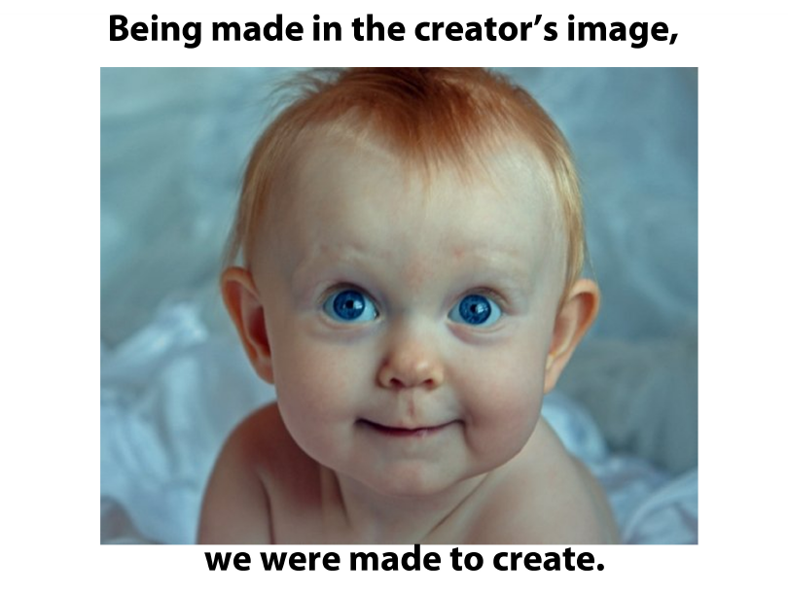
Notes:
Lesson Plan for Page 19
Go over vocabulary test
Test on verses Genesis 1:6-1:7 and Psalm 145:10
Start on final picture book project.
Write in online journal possible accompanying text

Slide 56
Lesson Plan for Page 19
Go over vocabulary test
Test on verses Genesis 1:6-1:7 and Psalm 145:10
Start on final picture book project.
Write in online journal possible accompanying text

Slide 57
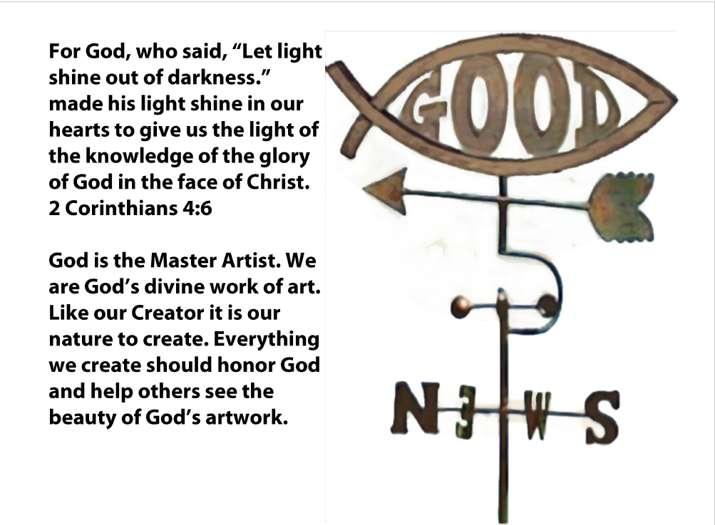
Notes:
Lesson Plan for Page 20
Go over test on verses.
Questions: Why did the artist choose this photograph for this page?
Discuss the meaning of the text on the page.
Memorize Verse 2 Corinthians 4:6
Review all vocabulary
Review all verses
Continue working on final project to create a picture book about creation.
Finals
Final test on all verses
Bonus question on 2 Corinthians 4:6
Final test on all vocabulary
Final project: Create a picture book about creation
Resources
Briggs, D. C., Diaz-Bilello, E., Peck, F., Alzen, J., Chattergoon, R., Johnson, R., & ... University of Colorado at Boulder, C. (. (2015). Using a Learning Progression Framework to Assess and Evaluate Student Growth. National Center For The Improvement Of Educational Assessment,
Hickey, D. d., Ingram-Goble, A. A., & Jameson, E. M. (2009). Designing Assessments and Assessing Designs in Virtual Educational Environments. Journal Of Science Education & Technology, 18(2), 187-208. doi:10.1007/s10956-008-9143-1
https://www.oxforddictionaries.com/
Metzer, Phil, The Artists Illustrated Encylopedia, North Light Books, 2001
Wiggins, G., & McTighe, J. (2005). Understanding by Design (Expanded ). Alexandria, US: Association for Supervision & Curriculum Development (ASCD). Retrieved from http://www.ebrary.com.library.esc.edu

Slide 58
Lesson Plan for Page 20
Go over test on verses.
Questions: Why did the artist choose this photograph for this page?
Discuss the meaning of the text on the page.
Memorize Verse 2 Corinthians 4:6
Review all vocabulary
Review all verses
Free Draw

Slide 59
Finals
Final test on all verses
Bonus question on 2 Corinthians 4:6
Final test on all vocabulary
Final project: Create a picture book about creation

Slide 60
Resources
Briggs, D. C., Diaz-Bilello, E., Peck, F., Alzen, J., Chattergoon, R., Johnson, R., & ... University of Colorado at Boulder, C. (. (2015). Using a Learning Progression Framework to Assess and Evaluate Student Growth. National Center For The Improvement Of Educational Assessment,
Hickey, D. d., Ingram-Goble, A. A., & Jameson, E. M. (2009). Designing Assessments and Assessing Designs in Virtual Educational Environments. Journal Of Science Education & Technology, 18(2), 187-208. doi:10.1007/s10956-008-9143-1
https://www.oxforddictionaries.com/
Metzer, Phil, The Artists Illustrated Encylopedia, North Light Books, 2001
Wiggins, G., & McTighe, J. (2005). Understanding by Design (Expanded ). Alexandria, US: Association for Supervision & Curriculum Development (ASCD). Retrieved from http://www.ebrary.com.library.esc.edu

